Slide 1
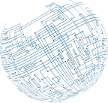

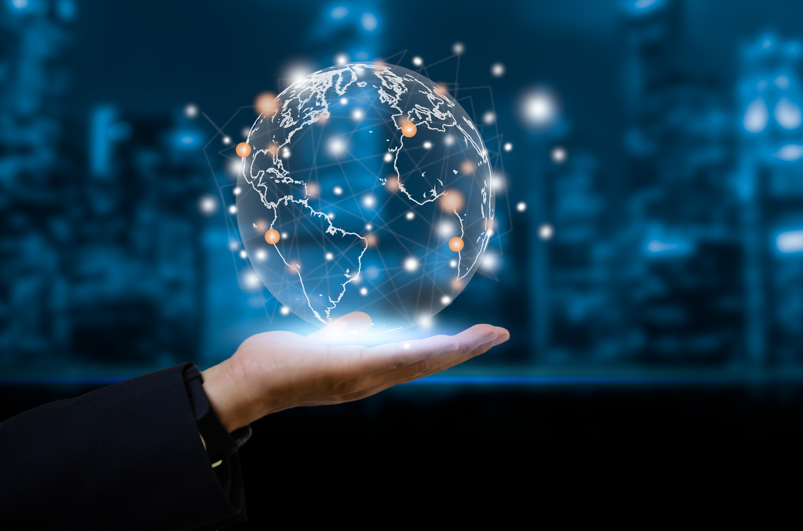

Embedded and
Specialized Systems

Slide 2
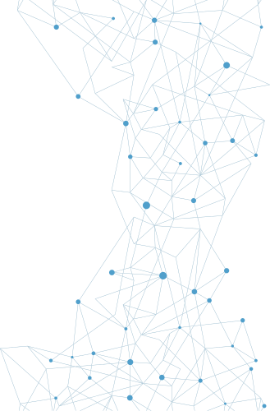

Embedded
Systems
Embedded systems is the name given to computers that are included as an integral part of a larger system, typically hardwired in. From computer peripherals like printers, to household devices like smart TVs and thermostats, to the car you drive, embedded systems are everywhere.

Slide 3
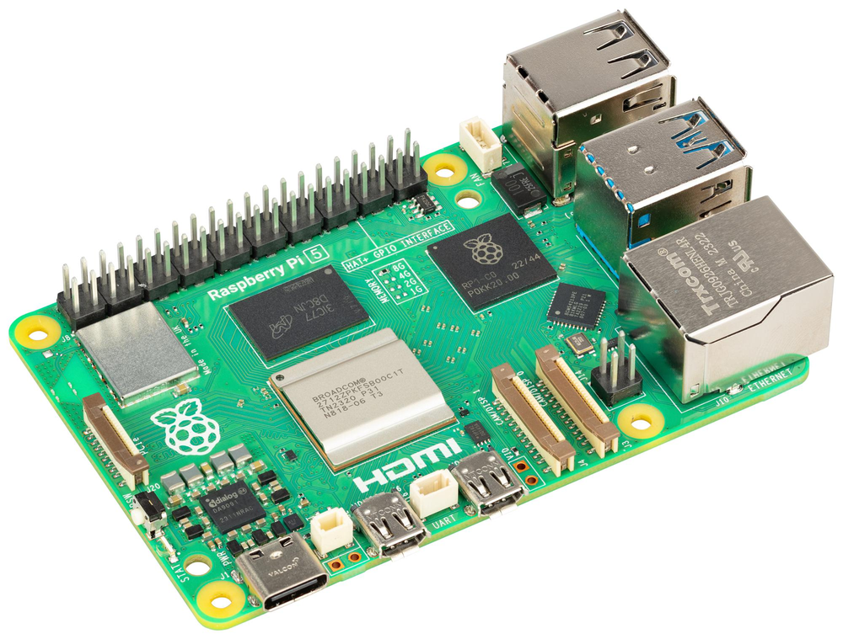
Embedded
Systems
RASPBERRY PI
The Raspberry Pi is a highly successful, low-cost, single-board computer. Millions of these devices have found their way into a wide range of applications—from use by hobbyists to prototype engineers, and even as production elements in some cases.

Slide 4
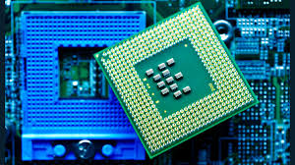
Embedded
Systems
FIELD PROGRAMMABLE GATE ARRAYS (FPGAS)
Field programmable gate arrays (FPGAs) are electronic circuits that are programmed to perform a specific function. These semiconductor devices are based around a matrix of configurable logic blocks (CLBs) that are connected via programmable interconnects, and in essence the logic is programmed before use.

Slide 5
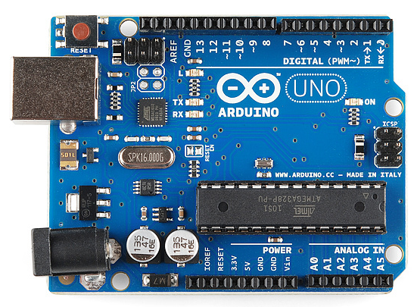
Embedded
Systems
ARDUINO
The Arduino is a single-board microcontroller, not a full-fledged computer like the Raspberry Pi. The Arduino is simpler, designed to provide computer control to hardware projects without the overhead of a full computer, OS, and so on.

Slide 6
Supervisory Control and Data Acquisition (SCADA) / Industrial Control System (ICS)
SCADA systems have their own smart components, each of which is an example of an embedded system. Together they form a SCADA system, which can control manufacturing plants, traffic lights, refineries, energy networks, water plants, building automation and environmental controls, and a host of other systems.

Slide 7
Supervisory Control and Data Acquisition (SCADA) / Industrial Control System (ICS)
FACILITIES
SCADA systems find many uses in facilities, ranging from the building automation systems of the HVAC system, to pumps for water pressure, escalators and elevators, and fire alarms—the lists just keep going on.

Slide 8
Supervisory Control and Data Acquisition (SCADA) / Industrial Control System (ICS)
INDUSTRIAL
Industrial facilities have some of the same needs as other facilities—the computer control of various processes, such as security, environmental monitoring, fire alarms, and more.

Slide 9
Supervisory Control and Data Acquisition (SCADA) / Industrial Control System (ICS)
MANUFACTURING
Manufacturing systems add another layer of computer-controlled processes to the industrial/facility mix—those of the actual manufacturing process itself. Manufacturing equipment is commonly computer controlled, using devices such as programmable logic controllers (PLCs), to execute a process-specific set of instructions based on sensor readings and actuator settings.

Slide 10
Supervisory Control and Data Acquisition (SCADA) / Industrial Control System (ICS)
ENERGY
Energy systems range from electrical to chemical, petroleum, pipelines, nuclear, solar, hydrothermal, and more. Each of these systems has multiple systems under computer control, typically using the same types of SCADA components as other categories already discussed.

Slide 11
Supervisory Control and Data Acquisition (SCADA) / Industrial Control System (ICS)
LOGISTICS
Logistics systems are the systems that move material from point A to point B. These systems can involve sea, surface (roads and rail), and air transport. There are two basic elements that will be under control: the transport system itself and the material being moved.

Slide 12
Internet
of Things (IoT)
The Internet of Things (IoT) is a term used to describe a wide range of devices that connect directly via the Internet to create a distributed sensor and processing system to achieve a specific function. As opposed to general-purpose devices, like computers and networking equipment, IoT devices are purpose built; they are designed to do a specific task.

Slide 13
Internet
of Things (IoT)
SENSORS
Sensors are devices that measure some physical item and return data that can be used by a system. Sensors come in an endless array of sizes, shapes, and physical constraints. Sensors can be used to measure temperatures, pressures, voltages, positions, humidity levels—the list goes on. Sensors can return the data as either a digital or analog signal.

Slide 14
Internet
of Things (IoT)
SMART DEVICES
Smart devices and devices that comprise the IoT have taken the world’s markets by storm. From key fobs that can track the location of items via GPS, to cameras that can provide surveillance, to connected household appliances, TVs, dishwashers, refrigerators, crock pots, washers, and dryers —anything with a microcontroller now seems to be connected to the Web so that it can be controlled remotely.

Slide 15
Internet
of Things (IoT)
WEARABLE
Wearable technologies include everything from biometric sensors measuring heart rate, to step counters measuring how far one walks, to smart watches that combine all these functions and more

Slide 16
Internet
of Things (IoT)
FACILITIES AUTOMATION
Automation is more than just remote operation; apps such as IFTTT (If This Then That) systems can respond to changing conditions and use multiple indicators, including dates and times. Automation can improve risk because it removes errors and improves speed of response.

Slide 17
Internet
of Things (IoT)
WEAK DEFAULTS
Weak defaults are a condition where default conditions are generally known, including admin account and password, leaving the system completely vulnerable to an attacker.

Slide 18
Specialized
Systems
MEDICAL SYSTEMS
Medical systems is a very diverse group—from small implantable devices, such as pacemakers, to multi-ton MRI machines. In between is a wide range of devices, from those that measure vital signs to those that actually control vital functions.

Slide 19
Specialized
Systems
VEHICLE SYSTEMS
A modern vehicle has not a single computer in it, but actually hundreds of them, all interconnected on a bus. The controller area network (CAN) bus is designed to allow multiple microcontrollers to communicate with each other without a central host computer.

Slide 20
Specialized
Systems
AIRCRAFT SYSTEMS
Aircraft also have a significant computer footprint inside, as most modern jets have what is called an “all-glass cockpit,” meaning the old individual gauges and switches have been replaced with a computer display that includes a touchscreen. This enables greater functionality and is more reliable than the older systems.

Slide 21
Specialized
Systems
SMART METERS
Smart meters is the common name for the advanced metering infrastructure, a program initiated by the Department of Energy to bring the functionality of remote automation to meters in utilities. Real-time two-way communications, computing infrastructure to analyze the data, and a whole host of new policies and procedures to take advantage of the automation have provided a revolution in utility operations

Slide 22
Voice Over
IP (VOIP)
Voice over IP—the transmission of voice communications over IP networks —is now a commonplace method of providing telephone services. VoIP makes telephone management as easy as an app in the enterprise, but it also brings security risks and vulnerabilities.

Slide 23
HVAC
Building-automation systems, climate-control systems, and HVAC (heating, ventilation, and air conditioning) systems are all examples of systems that are managed by embedded systems. Although these systems used to be independent and stand-alone systems, the rise of hyper-connectivity has shown value in integrating them.

Slide 24
HVAC
Voice over IP—the transmission of voice communications over IP networks —is now a commonplace method of providing telephone services. VoIP makes telephone management as easy as an app in the enterprise, but it also brings security risks and vulnerabilities.

Slide 25
DRONES
Drones, or unmanned aerial vehicles (UAVs), represent the next frontier of flight. These machines range from the small drones that hobbyists can play with for under $300 to full-size aircraft that can fly across oceans.

Slide 26
Multifunction printers (MFPs)
Multifunction printers (MFPs), which combine a printer, scanner, and fax, have embedded compute power to act as a print server, manage the actual printing or scanning process, and allow complete network connectivity. These devices communicate in a bidirectional fashion, accepting print job

Slide 27
Real-time operating systems (RTOSs)
Real-time operating systems (RTOSs) are designed for devices where the processing must occur in real time and data cannot be queued or buffered for any significant length of time. RTOSs are not general-purpose machines but are programmed for a specific purpose.

Slide 28
Surveillance systems
Digital surveillance systems have entered the computing world through a couple of different portals. There is the world of high-end digital cameras that have networking stacks, image processors, and even 4K video feeds.

Slide 29
System on a chip (SoC)
System on a chip (SoC) refers to a complete computer system miniaturized on a single integrated circuit, designed to provide the full functionality of a computing platform on a single chip. This includes networking and graphics display.

Slide 30
Communication Consideration
5G
5G is the latest generation mobile radio-based network. It is designed to connect virtually everyone and everything together, including machines, objects, and devices, with a focus on higher data speeds and bandwidth.

Slide 31
Communication Consideration
NARROW-BAND RADIO
Narrow-band radio communications use narrow bands of frequencies for low-data-rate communications. While a low data rate may seem to be a big problem, not all systems have high-data-rate needs, and narrow-band radio offers advantages in range and power utilization.

Slide 32
Communication Consideration
BASEBAND RADIO
Baseband radio refers to the signal that is being transmitted and represents a single channel of communication. Broadband radio is when multiple signals are bundled together for transmission, and equipment is typically required to separate out the individual communications.

Slide 33
Communication Consideration
SIM CARD
A subscriber identity module (SIM) card is a device used to hold key information needed to conduct communications across telecommunication networks. A SIM card provides a means of identifying users and other key items of information when using telecommunication networks.

Slide 34
Communication Consideration
ZIGBEE
Zigbee is a low-power mesh radio service used to connect sensors and basic devices.

Slide 35
Constraints
POWER
Power is a key driver in many embedded and specialized systems because it is a true limiter. When the power supply is interrupted and no backup power supply exists, the device stops functioning.

Slide 36
Constraints
COMPUTE
The compute capability of embedded and specialized systems is another key component that is matched to the task the device is designed to accomplish. Compute performance is one of the major elements in the power equation, and excess compute capacity results in more power drain and less useful life on a battery charge

Slide 37
Constraints
NETWORK
Network limitations are due to constraints from power and connectivity. Without direct connectivity, networking requires a radio transceiver, and this increases power demands. Therefore, where networking is needed, it comes at a cost.

Slide 38
Constraints
CRYPTOGRAPHIC FUNCTIONS
Cryptographic functions can be essential to secure data during transmission, but this functionality comes at a price. The level of computational resources for crypto functions can be substantial, thus becoming a constraint on the overall system.

Slide 39
Constraints
INABILITY TO PATCH
The inability to patch an item represents a security risk and a constraint. This is typically caused by a series of design decisions predicated on producing items that are not computers but rather single-purpose devices.

Slide 40
Constraints
AUTHENTICATION
Authentication is an important predicate to security functionality. The definitions of confidentiality, integrity, and many other security attributes have the term authenticated user in them. This make authentication an important property, but given the non-computer ecosystem in which most specialized and embedded devices function, there is a problem with directly adopting the concept of authentication.

Slide 41
Constraints
RANGE
In most cases, range is a function of power—one of the true limitations of many specialized and embedded systems. One of the challenges of IoT deployments is getting them to the Internet, because there range is unlimited. However, this comes at the cost of security/risk.

Slide 42
Constraints
COST
The whole purpose behind developing specialized/embedded systems is that the value is there. The functionality return for the cost of the unit justifies the design and deployment, so cost is to a degree baked in. So, rather than viewing cost as a constraint, it is the factor that drives the creation of these solutions.

Slide 43
Constraints
IMPLIED TRUST
Implied trust, by definition, is trust that has not been specifically set up but yet exists. This is almost a given in many specialized systems because they are not intended or designed to be general-purpose compute devices; therefore, the thought processes associated with regular trust vis-à-vis computers and the Internet do not exist.

Slide 44
Thank
You

